Slide 1
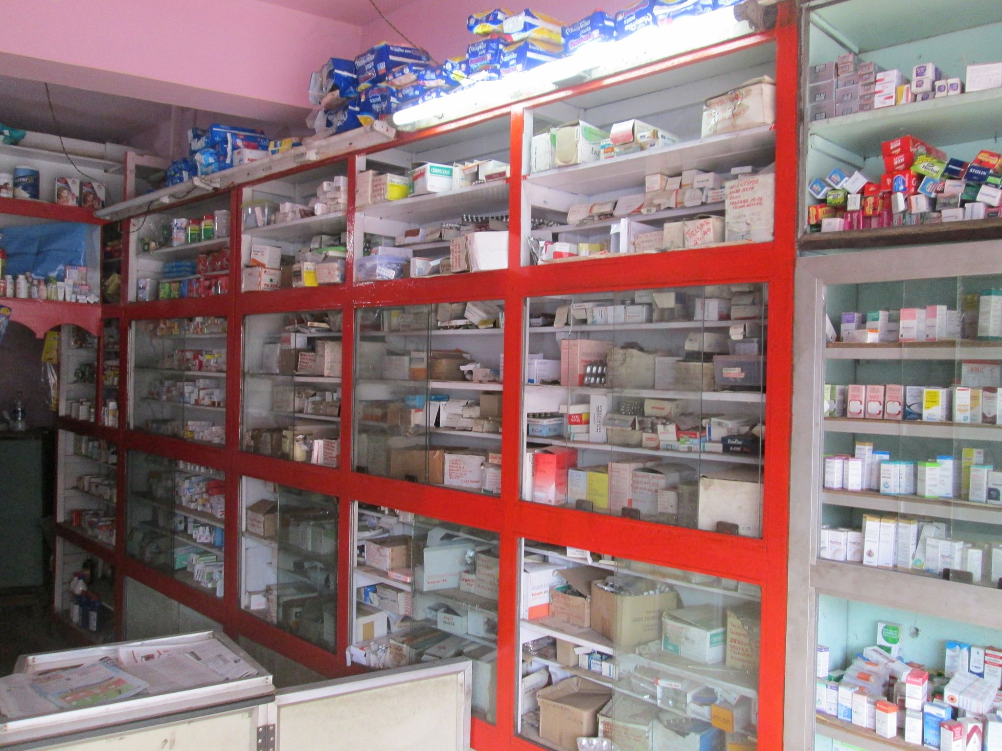
WELCOME MEDICAL STORE INFORMATION SYSTEM

Slide 2
Introduction
This mini project is a very comprehensive one. File handling has been extensively and effectively used for almost major functions. The whole project is based on file handling as all medical records are stored in file.
Data structure have been used to store and organize records. Overall, understanding this project will provide you valuable information on how to store, edit, search and delete data using file.
Here, you can input many information like medicine Name, rack no., MGF. Date, EXP. Date, Medicine Qty., Price, etc. while adding a medicine into the store.

Slide 3
Project Objectives
The main goal of the project is to obtain the complete and correct information. Because Medical Store or Store keeper need to maintains a record of:
The Supplier
The Customer
The Medicine

Slide 4
System Design
MEDICAL STORE INFORMATION SYSTEM
MEDICINE SECTION
SUPPLIER SECTION
CUSTOMER SECTION

Slide 5
Use Case Diagram
SUPPLIER SECTION
ADD SUPPLIER
VIEW SUPPLIER
MODIFY SUPPLIER
SEARCH SUPPLIER
DELETE SUPPLIER
BACK TO MAIN
CLOSE APPLICATION

Slide 6
Use Case Diagram
CUSTOMER SECTION
ADD CUSTOMER
VIEW CUSTOMER
MODIFY CUSTOMER
SEARCH CUSTOMER
DELETE CUSTOMER
CLOSE APPLICATION
BACK TO MAIN

Slide 7
Use Case Diagram
MEDICINE SECTION
ADD MEDICINE
VIEW MEDICINE
UPDATE MEDICINE
SEARCH MEDICINE
DELETE MEDICINE
BACK TO MAIN
CLOSE APPLICATION

Slide 8
Tools/Platforms and Languages Used
Hardware Configuration
Processor: Intel Processor
Main Memory: 4 RAM
HDD: 500 GB
Software
Operating System : Windows 10
Programming Language: C
IDE : Code Block
Compiler : GCC
Documentation: MS-WORD 2016
Backup media: Hard Disk Backup

Slide 9
Future Enhancement
Data Validation
Security
Sorting of IDs

Slide 10

Contributor , Supervisor & Audience

